Slide 1
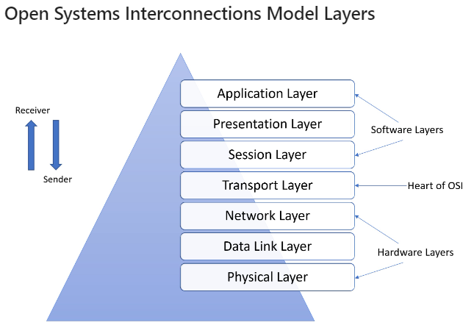
OSI

Slide 2
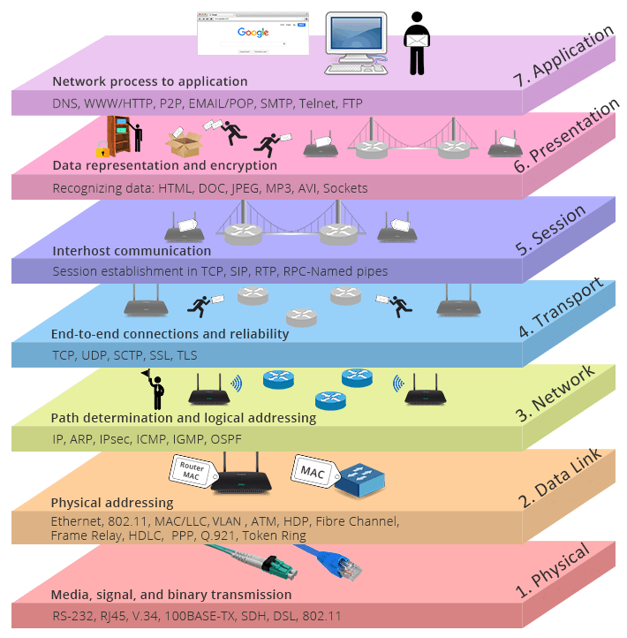

Slide 3
OSI MODEL
The open systems interconnection (OSI) model is a conceptual model created by the International Organization for Standardization (1970’s) which enables diverse communication systems to communicate using standard protocols.
OSI is not a protocol; it is a model for understanding & desiging a network architecturethat is flexable, robust & interoperable.
The seven layers of function are provided by a combination of applications, operating systems (OSes), network card device drivers, networking hardware and protocols that enable a system to transmit a signal over a network through various physical mediums, including twisted-pair copper, fiber optics, Wi-Fi or Long-Term Evolution (LTE) with 5G.

Slide 4
Cont..
In this architecture, each layer serves the layer above it and, in turn, is served by the layer below it.
So, in a given message between users, there will be a flow of data down through the layers in the source computer, across the network and then up through the layers in the receiving computer.
Only the application layer at the top of the stack doesn't provide services to a higher-level layer.
The main concept of OSI is that the process of communication between two endpoints in a network can be divided into seven distinct groups of related functions, or layers.

Slide 5
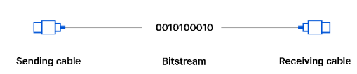
1- PHYSICAL LAYER
This layer includes the physical equipment involved in the data transfer, such as the cables and switches. This is also the layer where the data gets converted into a bit stream, which is a string of 1s and 0s. The physical layer of both devices must also agree on a signal convention so that the 1s can be distinguished from the 0s on both devices.

Slide 6
Cont..
The phsical layer is also concerned with the following:
Physical characterstics of interfaces and medium
Representation of Bits
Data rate
Synchronization of Bits
Line configuration
Physical topology
Transmission mode

Slide 7
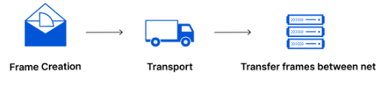
2- DATA LINK LAYER
the data link layer facilitates data transfer between two devices on the same network.
The data link layer takes packets from the network layer and breaks them into smaller pieces called frames.
Like the network layer, the data link layer is also responsible for flow control and error control in intra-network communication (The transport layer only does flow control and error control for inter-network communications).

Slide 8
Cont..
Few others responsibilities of DLL are as follows:
Framing
Physical Addressing
Flow Control
Error Control
Access Control

Slide 9
3- NETWORK LAYER
The network layer is responsible for facilitating data transfer between two different networks.
If the two devices communicating are on the same network, then the network layer is unnecessary.
The network layer breaks up segments from the transport layer into smaller units, called packets, on the sender’s device, and reassembling these packets on the receiving device.
The network layer also finds the best physical path for the data to reach its destination; this is known as routing.

Slide 10
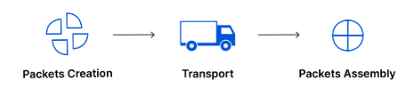
Cont..
Logical addressing and Routing is one of the main responsibility of the network layer.
Network layer protocols include IP, the Internet Control Message Protocol (ICMP), the Internet Group Message Protocol (IGMP), and the IPsec suite.

Slide 11
4- TRANSPORT LAYER
Layer 4 is responsible for end-to-end communication between the two devices.
This includes taking data from the session layer and breaking it up into chunks called segments before sending it to layer 3.
The transport layer on the receiving device is responsible for reassembling the segments into data the session layer can consume.
The transport layer is also responsible for flow control and error control. Flow control determines an optimal speed of transmission to ensure that a sender with a fast connection does not overwhelm a receiver with a slow connection.

Slide 12
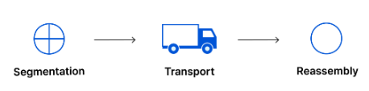
Cont..
The transport layer performs error control on the receiving end by ensuring that the data received is complete, and requesting a retransmission if it isn’t.
Transport layer protocols include the Transmission Control Protocol (TCP) and the User Datagram Protocol (UDP).

Slide 13
5- SESSION LAYER
This is the layer responsible for opening and closing communication between the two devices.
The time between when the communication is opened and closed is known as the session.
The session layer ensures that the session stays open long enough to transfer all the data being exchanged, and then promptly closes the session in order to avoid wasting resources.
The session layer also synchronizes data transfer with checkpoints

Slide 14
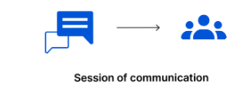
Cont..
Dialog Control & Synchronization are specific responsibilities for this layer.

Slide 15
6- PRESENTATION LAYER
This layer is primarily responsible for preparing data so that it can be used by the application layer.
The presentation layer is responsible for translation, encryption, and compression of data.
Two communicating devices communicating may be using different encoding methods, so layer 6 is responsible for translating incoming data into a syntax that the application layer of the receiving device can understand.
the presentation layer is also responsible for compressing data it receives from the application layer before delivering it to layer 5.

Slide 16
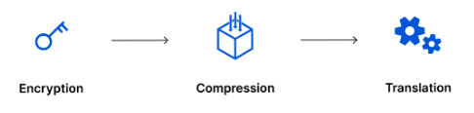
Cont..
This helps improve the speed and efficiency of communication by minimizing the amount of data that will be transferred.

Slide 17
7- Application Layer
This is the only layer that directly interacts with data from the user.
Software applications like web browsers and email clients rely on the application layer to initiate communications.
But it should be made clear that client software applications are not part of the application layer; rather the application layer is responsible for the protocols and data manipulation that the software relies on to present meaningful data to the user.
Application layer protocols include HTTP as well as SMTP (Simple Mail Transfer Protocol is one of the protocols that enables email communications).

Slide 18

Cont..

Slide 19
